Slide 1
Chapter 14 Database Design Theory-Introduction to Normalization using Functional Dependencies and Multivalued Dependencies

Slide 2
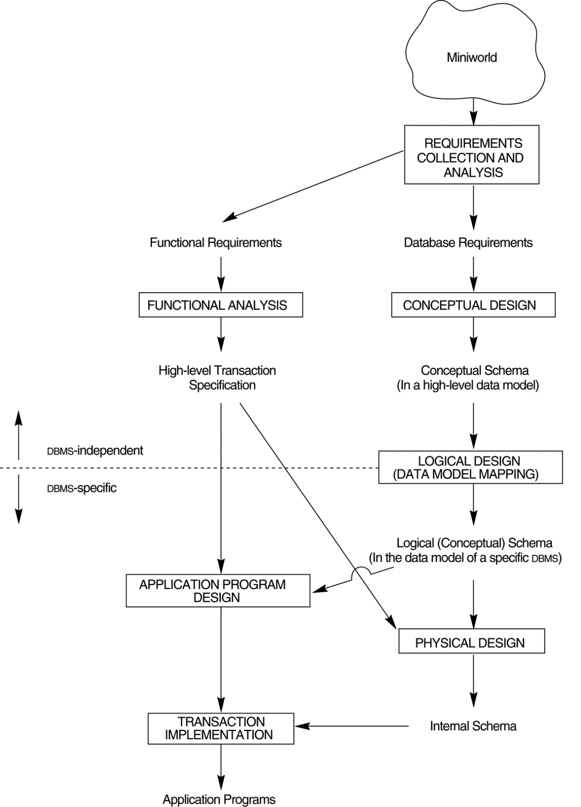
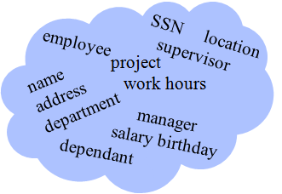
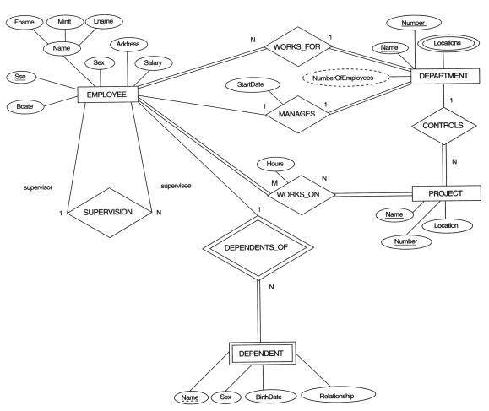
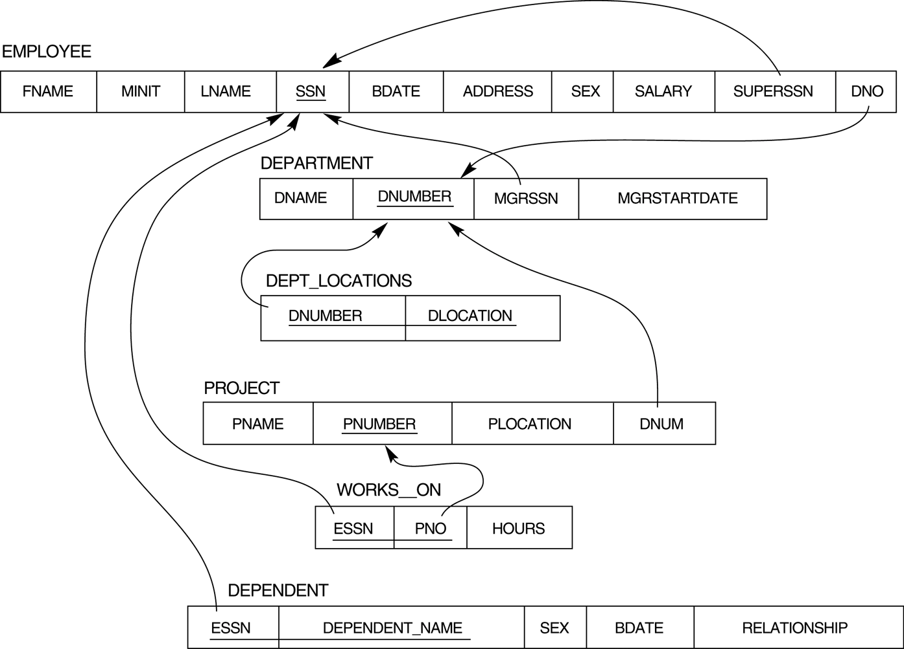
Mini-world
DB
DBMS
ER diagram
Quality? (ch. 14,15)

Slide 3
Relational Schema Quality
Schema Quality?
Which Normal Form?
1NF, 2NF, 3NF, BCNF?
Functional Dependency

Slide 4
Chapter Outline
Informal Design Guidelines for Relational Databases
Functional Dependencies (FDs)
Normal Forms Based on Primary Keys
General Normal Form Definitions (For Multiple Keys)
BCNF (Boyce-Codd Normal Form)
Multivalued Dependency and Fourth Normal Form
Join Dependencies and Fifth Normal Form

Slide 5
Informal Design Guidelines
What is relational database design?
The grouping of attributes to form "good" relation schemas
Two levels of relation schemas
The logical "user view" level
The storage "base relation" level
Design is concerned mainly with base relations
What are the criteria for "good" base relations?
employee
SSN location
supervisor
name
address
department
project
work hours
manager
salary birthday
dependant
Relevant Attributes of Mini-World

Slide 6
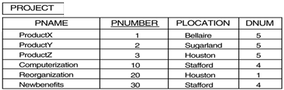
Informal Design Guidelines
Semantics of the Relation Attributes
Redundant Information in Tuples and Update Anomalies
Null Values in Tuples
Spurious Tuples

Slide 7
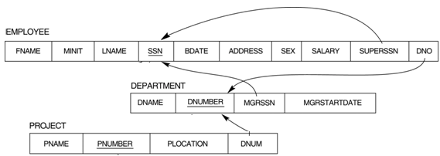

Semantics of the Relation Attributes
GUIDELINE 1
Informally, each tuple in a relation should represent one entity or relationship instance. (Applies to individual relations and their attributes).
Attributes of different entities (EMPLOYEEs, DEPARTMENTs, PROJECTs) should not be mixed in the same relation
Only foreign keys should be used to refer to other entities
Entity and relationship attributes should be kept apart as much as possible.
Bottom Line: Design a schema that can be explained easily relation by relation. The semantics of attributes should be easy to interpret.

Slide 8
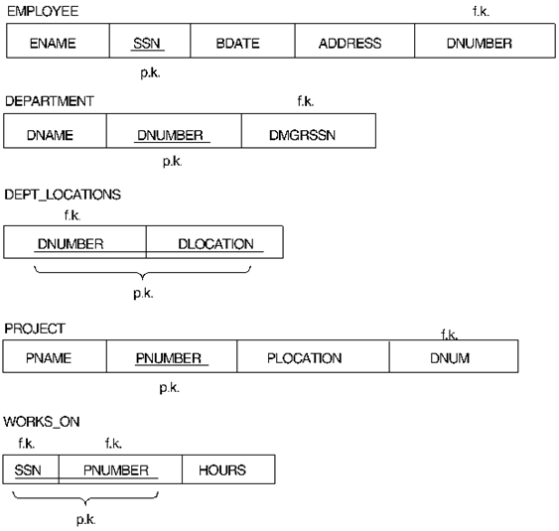


A simplified COMPANY relational database schema
Attributes of different entities (EMPLOYEEs, DEPARTMENTs, PROJECTs) should not be mixed in the same relation
Only foreign keys should be used to refer to other entities.
Entity and relationship attributes should be kept apart as much as possible.

Slide 9
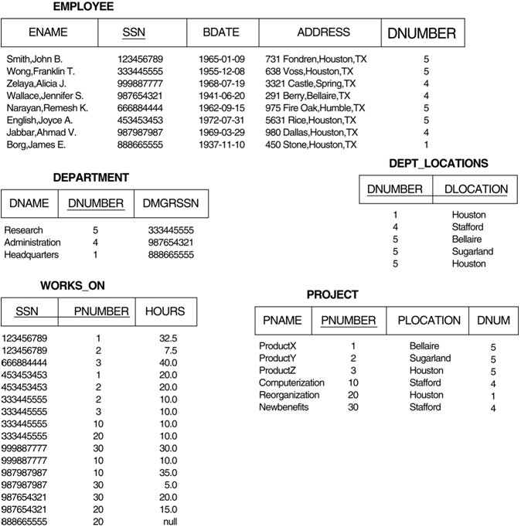
Each tuple in a relation should represent one entity or relationship instance.

Slide 10
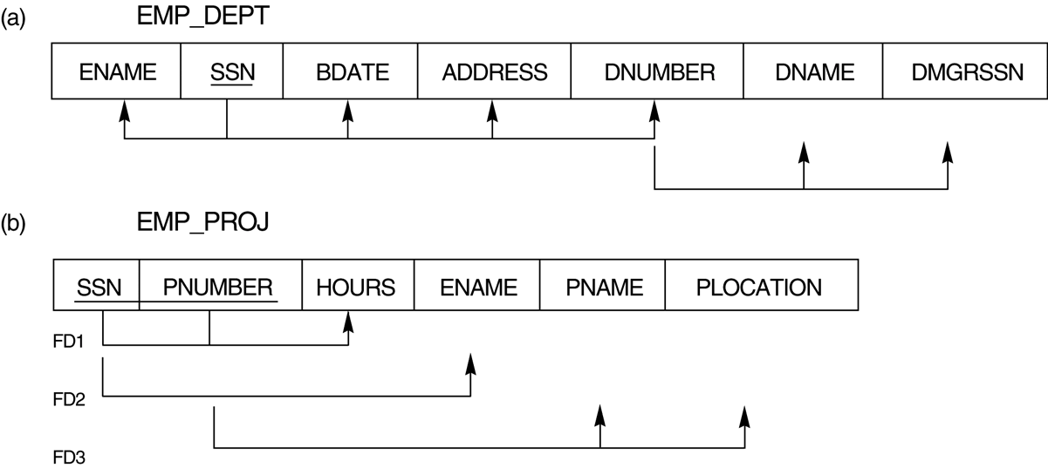
FIGURE 14.3 Two relation schemas suffering from update anomalies.
Bad design:
Violate Guideline 1 by mixing attributes from distinct real-world entities.

Slide 11
Redundant Information in Tuples and Update Anomalies
Mixing attributes of multiple entities may cause problems
Information is stored redundantly wasting storage
Problems with update anomalies
Insertion anomalies
Deletion anomalies
Modification anomalies

Slide 12
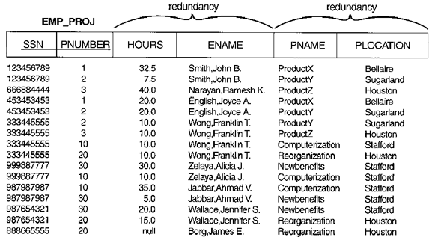
Modification Anomaly:
Changing the name of project number P1 from “ProductX” to “Customer-Accounting” may cause this update to be made for all 100 employees working on project P1.

Slide 13
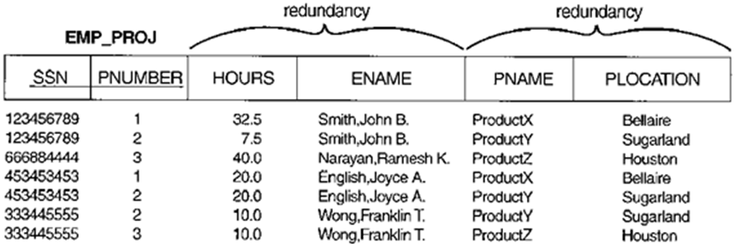
Insert Anomaly:
Cannot insert a project unless an employee is assigned to.
Inversely cannot insert an employee unless an he/she is assigned to a project.
Delete Anomaly:
When a project is deleted, it will result in deleting all the employees who work on that project.
Alternately, if an employee is the sole employee on a project, deleting that employee would result in deleting the corresponding project.

Slide 14
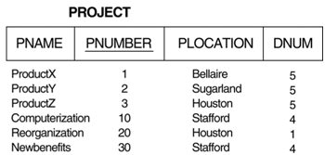
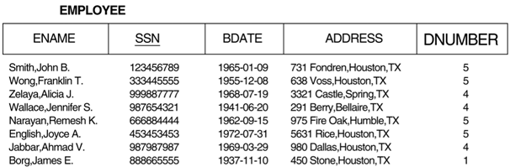
Guideline to Redundant Information
GUIDELINE 2:
Design a schema that does not suffer from the insertion, deletion and update anomalies. If there are any present, then note them so that applications can be made to take them into account
Change P1’s name
Insert a new project without assigning any worker yet
Delete a project or an employee

Slide 15



Guideline to Redundant Information
GUIDELINE 3:
Relations should be designed such that their tuples will have as few NULL values as possible
Attributes that are NULL frequently could be placed in separate relations (with the primary key)
Reasons for nulls:
attribute not applicable or invalid (e.g. office phone no. of a student)
attribute value unknown (may exist) (e.g. name of spouse)
value known to exist, but unavailable (e.g. weight of a female)
(1000 tuples)
(1000 tuples)
(50 tuples)

Slide 16
Spurious Tuples
Bad designs for a relational database may result in erroneous results for certain JOIN operations
The "lossless join" property is used to guarantee meaningful results for join operations
GUIDELINE 4
The relations should be designed to satisfy the lossless join condition:
No spurious tuples should be generated by doing a natural-join of any relations.

Slide 17
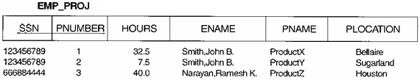
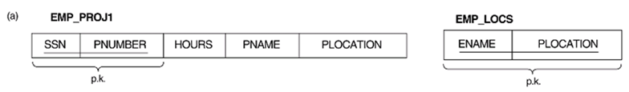
FIGURE 14.5 Particularly poor design for the EMP_PROJ relation of Figure 14.3b.
The two relation schemas EMP_LOCS and EMP_PROJ1.
The result of projecting the extension of EMP_PROJ from Figure 14.4 onto the relations EMP_LOCS and EMP_PROJ1.
… … …
decompose
natural join
EMP_PROJ
Shall not generate spurious tuples.

Slide 18
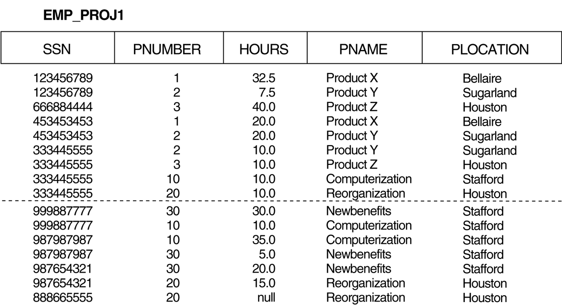
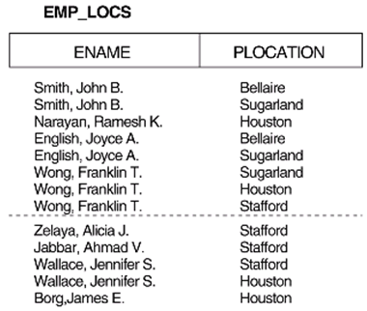
FIGURE 14.5 (continued) The result of projecting the extension of EMP_PROJ from Figure 14.4 onto the relations EMP_LOCS and EMP_PROJ1.
… … …
decompose
natural joint

Slide 19
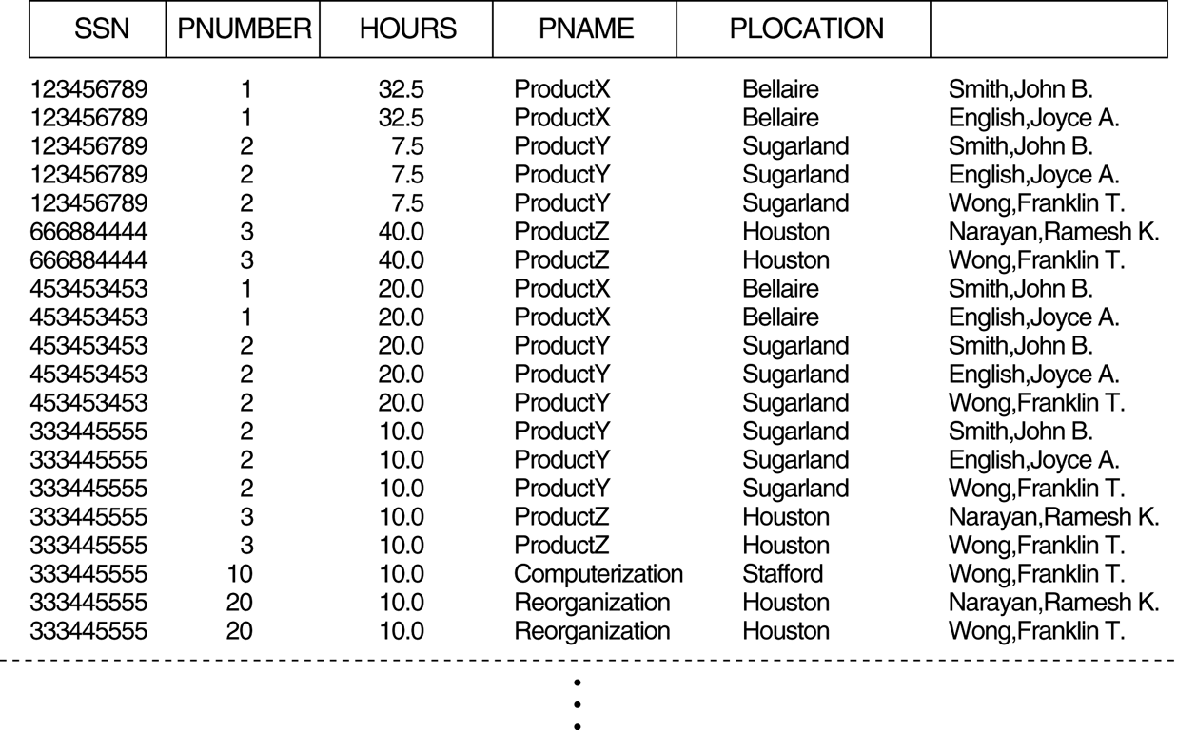
FIGURE 14.6 Result of applying NATURAL JOIN to the tuples above the dotted lines in EMP_PROJ1 and EMP_LOCS of Figure 14.5. Generated spurious tuples are marked by asterisks (*).
*
*
*
*
*
*
*
*
*
*
*

Slide 20
Quality of Database Schema
Schema Quality?
Which Normal Form is each relation in?
Shall be in 3NF or BCNF at least .

Slide 21
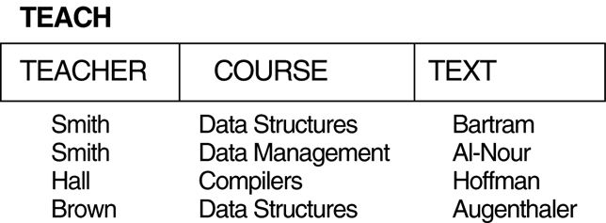
Functional Dependencies and Normal Forms
2. Functional Dependencies (FDs)
3. Normal Forms Based on Primary Keys
3.1 Normalization of Relations
3.2 Practical Use of Normal Forms
3.3 Definitions of Keys and Attributes Participating in Keys
3.4 First Normal Form
3.5 Second Normal Form
3.6 Third Normal Form
4. General Normal Form Definitions (For Multiple Keys)
5. BCNF (Boyce-Codd Normal Form)
Which NF?
Functional Dependency

Slide 22

Examples of Functional Dependency
Social security number determines employee name
SSN → ENAME
ENAME → SSN (?)
Project number determines project name and location
PNUMBER → {PNAME, PLOCATION}
PNUMBER → PNAME (?)
Employee ssn and project number determines the hours per week that the employee works on the project
{SSN, PNUMBER} → HOURS
SSN → HOURS (?)
An FD is a property of the attributes in the schema R
The constraint must hold on every relation instance r(R)

Slide 23
Functional Dependencies 功能相依
X → Y holds
If whenever two tuples have the same value for X, they must have the same value for Y
e.g. {StudentID} → {Name}
{SSN} → {Address}
{Name, Birthday} → {Address, Dept., Sex}
For any two tuples t1 and t2 in any relation instance r(R)
If t1[X] = t2[X], then t1[Y] = t2[Y]
X → Y in R specifies a constraint on all relation instances r(R)
FDs are derived from the real-world constraints on the attributes

Slide 24
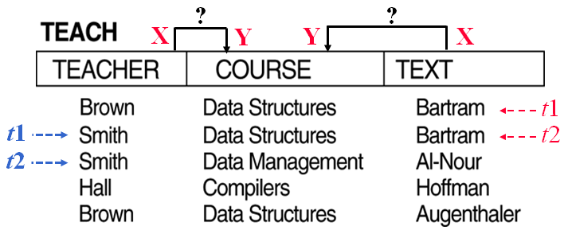
Definition of Functional Dependency
X → Y
A set of attributes X functionally determines a set of attributes Y if the value of X determines a unique value for Y.
If t1[X] = t2[X], then t1[Y] = t2[Y]
A relation state of TEACH with
A possible functional dependency TEXT → COURSE. However, TEACHER → COURSE is ruled out. (Smith違反)

Slide 25
Functional Dependencies
Functional dependencies (FDs) are used to specify formal measures of the "goodness" of relational designs
FDs and keys are used to define normal forms for relations
FDs are constraints that are derived from the meaning and interrelationships of the data attributes
Schema Quality?
Which Normal Form?
1NF, 2NF, 3NF, BCNF?
Functional Dependency

Slide 26
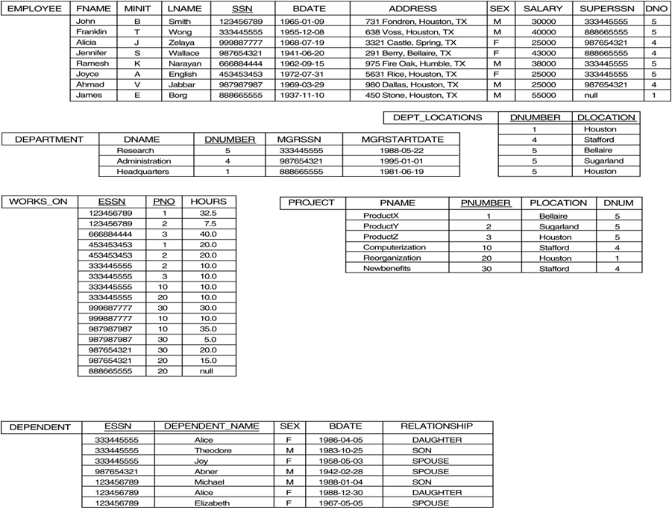
If K is a key of R, then K functionally determines all attributes in R (since we never have two distinct tuples with t1[K] = t2[K])
The FD constraint must hold on every relation instance r(R)
{ESSN, DEPENDENT_NAME} → {SEX, BDATE, RELATIONSHIP}
key

Slide 27
3 Normal Forms Based on Primary Keys
3.1 Normalization of Relations
3.2 Practical Use of Normal Forms
3.3 Definitions of Keys and Attributes Participating in Keys
3.4 First Normal Form
3.5 Second Normal Form
3.6 Third Normal Form
Which NF is TEACH in?

Slide 28
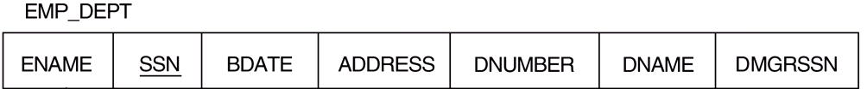
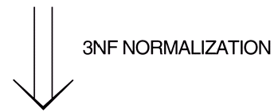


14.3.1 Normalization of Relations
Normalization:
The process of decomposing unsatisfactory "bad" relations by breaking up their attributes into smaller relations
Normal form:
Condition using keys and FDs of a relation to certify whether a relation schema is in a particular normal form
2NF, 3NF, BCNF based on keys and FDs of a relation schema
4NF based on keys and multi-valued dependencies (MVD)
5NF based on keys and join dependencies (JD)
2NF
3NF
3NF

Slide 29
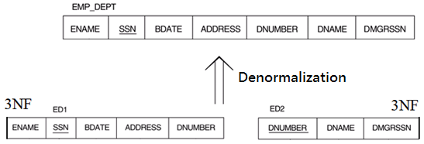
14.3.2 Practical Use of Normal Forms
Normalization is carried out in practice so that the resulting designs are of high quality and meet the desirable properties
The practical utility of these normal forms becomes questionable when the constraints on which they are based are hard to understand or to detect
The database designers need not normalize to the highest possible normal form. (usually up to 3NF, BCNF or 4NF)
Denormalization:
the process of storing the join of higher normal form relations as a base relation—which is in a lower normal form

Slide 30
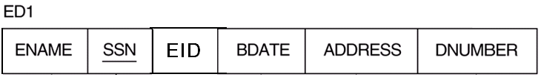
14.3.3 Definitions of Keys and Attributes Participating in Keys (1)
A superkey of a relation schema R = {A₁, A₂, ...., A_{n}}
a set of attributes S subset-of R with the property that no two tuples t₁ and t₂ in any legal relation state r of R will have t₁[S] = t₂[S]
A key K is a superkey with the additional property that removal of any attribute from K will cause K not to be a superkey any more.
If a relation schema has more than one key, each is called a candidate key. One of the candidate keys is arbitrarily designated to be the primary key, and the others are called secondary keys.
A Prime attribute must be a member of some candidate key.
A Nonprime attribute is not a prime attribute.
that is, it is not a member of any candidate key.
{SSN, EID, ADDRESS}
{SSN}
{EID}
{DNUMBER}

Slide 31
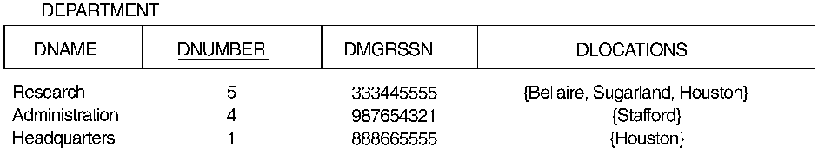
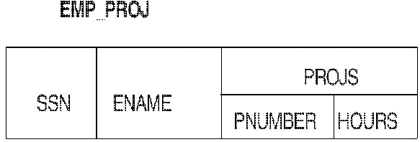
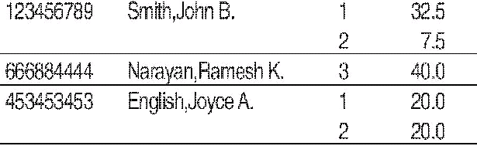
14.3.4 First Normal Form
1NF disallows composite attributes, multivalued attributes, and nested relations; attributes whose values for an individual tuple are non-atomic
Nested relation
Multivalued attribute

Slide 32
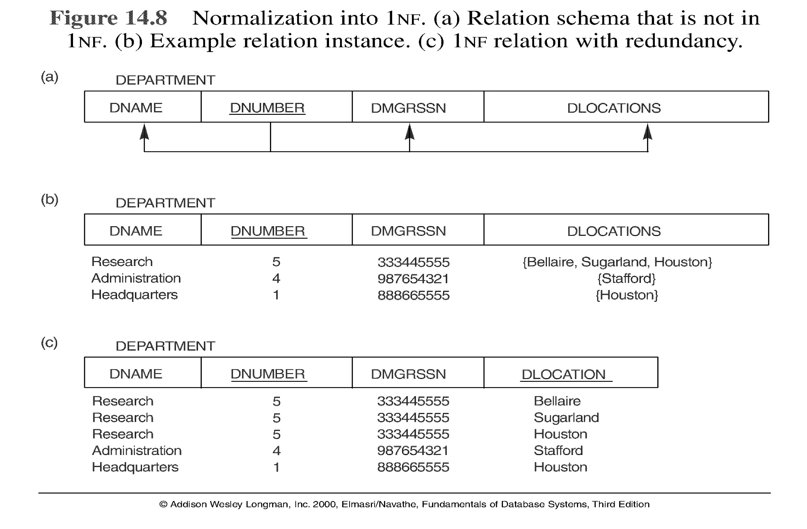
Normalization into 1NF
simple attribute

Slide 33
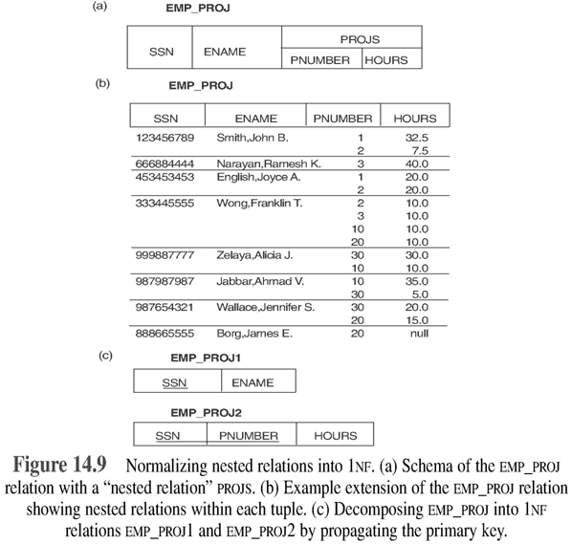
Normalization nested relations into 1NF

Slide 34
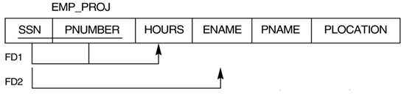
Full Functional Dependency
Uses the concepts of primary key and FDs
Prime attribute
attribute that is member of the primary key K
Full functional dependency
a FD Y → Z where removal of any attribute from Y means the FD does not hold any more
Examples:
- {SSN, PNUMBER} → ENAME is not a full FD
since SSN → ENAME also holds (it is called a partial dependency )
- {SSN, PNUMBER} → HOURS is a full FD
since neither SSN →HOURS nor PNUMBER → HOURS hold

Slide 35
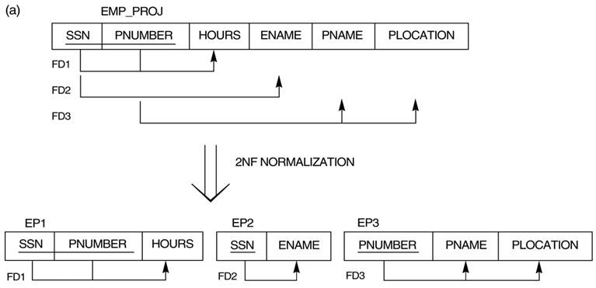
Second Normal Form
A relation schema R is in second normal form (2NF)
if every non-prime attribute A in R is fully functionally dependent on the primary key
R can be decomposed into 2NF relations via the process of 2NF normalization
Non-prime attribute is not allowed partially functionally dependent on the primary key.

Slide 36
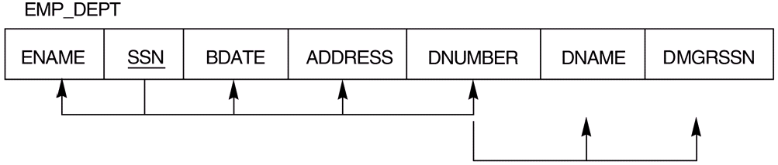
Transitive Functional Dependency
Definition:
Transitive functional dependency
a FD X→Z that can be derived from two FDs X→Y and Y→Z
Examples:
- SSN→DMGRSSN is a transitive FD
since SSN→DNUMBER and DNUMBER→DMGRSSN hold
- SSN→ENAME is non-transitive
since there is no set of attributes X where SSN→X and X→ENAME

Slide 37
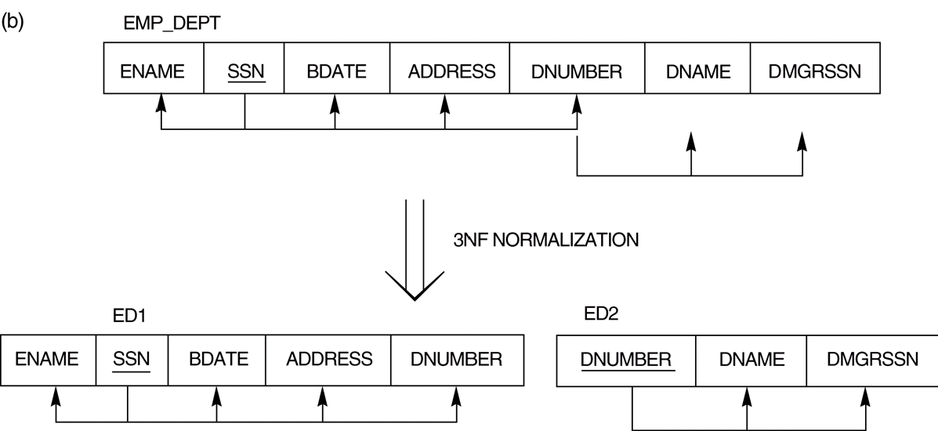
Third Normal Form
A relation schema R is in third normal form (3NF)
if it is in 2NF and no non-prime attribute A in R is transitively dependent on the primary key
R can be decomposed into 3NF relations via the process of 3NF normalization
SSN→DNUMBER
DNUMBER→DMGRSSN
∴ SSN→DMGRSSN is a transitive FD
DMGRSSN is a non-prime attribute and transitively dependent on the primary key.

Slide 38
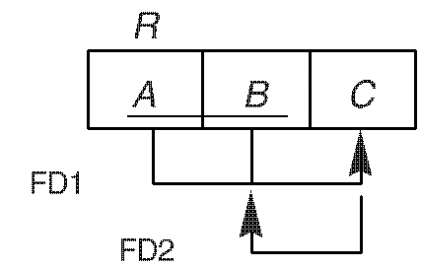
4. General Normal Form Definitions (For Multiple Keys)
The previous definitions consider the primary key only
The following more general definitions take into account relations with multiple candidate keys
Superkey of relation schema R
a set of attributes S of R that contains a key of R
Second normal form (2NF) R:
if every non-prime attribute A in R is fully functionally dependent on every key of R
Third normal form (3NF) R:
if whenever a FD X→Y holds in R, then either:
(a) X is a superkey of R, or
(b) Y is a prime attribute of R
AB→C
C→B

Slide 39
Example of General Third Normal Form
Example
In X → Y and Y → Z, with X as the primary key,
we consider this a problem only if Y is not a superkey.
When Y is a superkey, there is no problem with the transitive dependency .
E.g., Consider EMP(SSN, Emp#, Salary ).
SSN → Emp# ; Emp# → Salary
Here, SSN → Salary (no problem, since Emp# is a superkey)
The relation is in 3rd normal form.

Slide 40
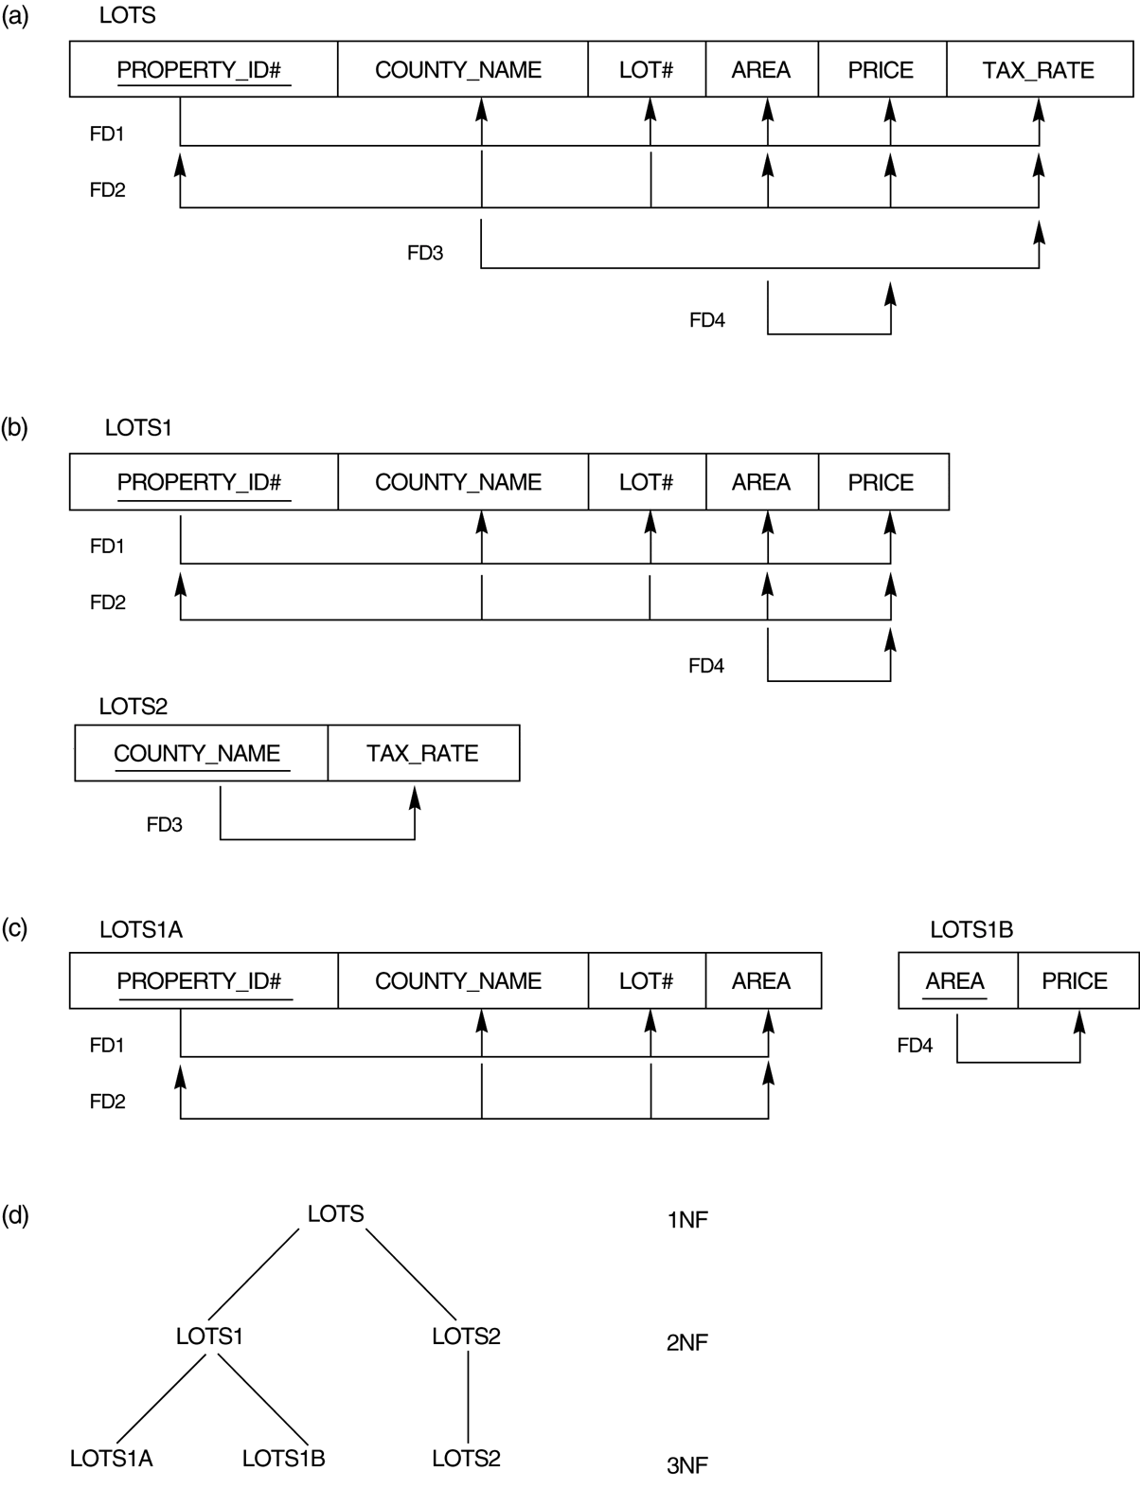
FIGURE Normalization into 2NF and 3NF. (a) the LOTS relation with its functional dependencies FD1 though FD4. (b) Decomposing into the 2NF relations LOTS1 and LOTS2. (c) Decomposing LOTS1 into the 3NF relations LOTS1A and LOTS1B. (d) Summary of the progressive normalization of LOTS.
not in 2NF
not in 3NF
In (a)
PROPERTY_ID#
is a primary key.
{COUNTY_NAME, LOT#} is a candidate key.

Slide 41
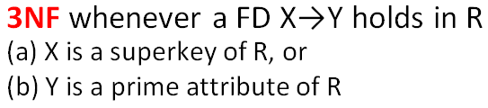
5 BCNF (Boyce-Codd Normal Form)
A relation schema R is in Boyce-Codd Normal Form (BCNF)
if whenever an FD X→Y holds in R,
then X is a superkey of R
Example: R in 3NF but not in BCNF
Each normal form is strictly stronger than the previous one
Every 2NF relation is in 1NF
Every 3NF relation is in 2NF
Every BCNF relation is in 3NF
There exist relations that are in 3NF but not in BCNF
DB design goal is to have each relation in BCNF (or 3NF)
AB→C
C→B

Slide 42
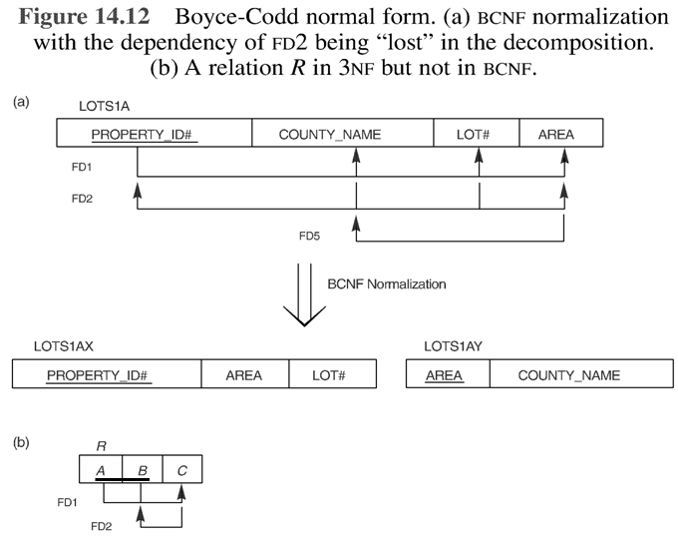
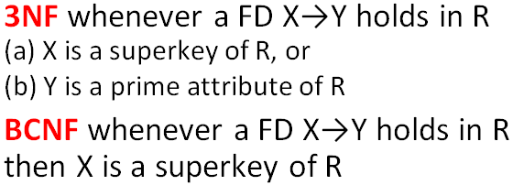
Boyce-Codd Normal Form
Not in BCNF
{COUNTY_NAME, LOT#} is a superkey, but {AREA} is not.
AB→C
C→B

Slide 43

Figure a relation TEACH that is in 3NF but not in BCNF
FD1: STUDENT COURSE → INSTRUCTOR
FD2: INSTRUCTOR→COURSE
FD2
FD1

Slide 44

Achieving the BCNF by Decomposition (2)
Three possible decompositions for relation TEACH
{student, instructor} and {student, course}
{course, instructor } and {course, student}
{instructor, course } and {instructor, student}
All three decompositions will lose FD1. We have to settle for sacrificing the functional dependency preservation. But we cannot sacrifice the non-additivity property (i.e., lossless joint property) after decomposition.
Out of the above three, only the 3rd decomposition will not generate spurious tuples after join.(and hence has the non-additivity property).
A test to determine whether a binary decomposition (decomposition into two relations) is nonadditive (lossless) is discussed in section 15.2.4 under Property LJ1. Verify that the third decomposition above meets the property.
FD1: STUDENT COURSE → INSTRUCTOR
FD2: INSTRUCTOR → COURSE

Slide 45
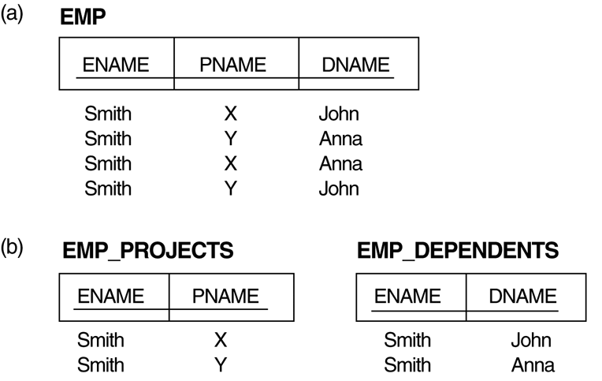
6. Multivalued Dependencies and Fourth Normal Form
The EMP relation with two MVDs: ENAME —>> PNAME and ENAME —>> DNAME.
Decomposing the EMP relation into two 4NF relations EMP_PROJECTS and EMP_DEPENDENTS.
Different from F.D.:
SSN→ENAME

Slide 46
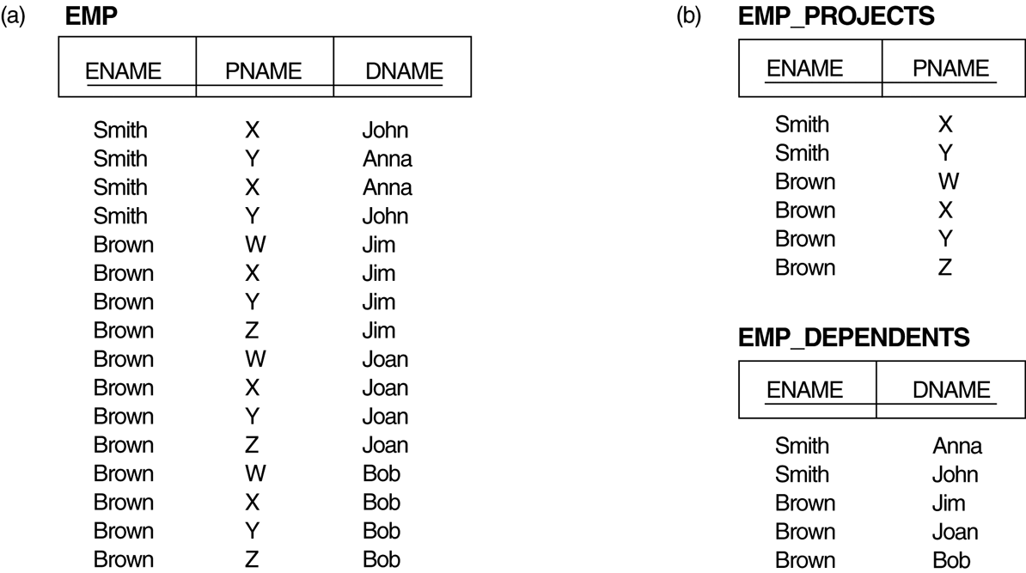
Multivalued Dependencies and Fourth Normal Form
Decomposing a relation state of EMP that is not in 4NF.
EMP relation with additional tuples.
Two corresponding 4NF relations EMP_PROJECTS and EMP_DEPENDENTS.

Slide 47
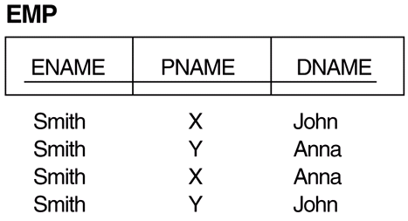
Multivalued Dependencies
A multivalued dependency (MVD) X —>> Y specified on relation schema R, where X and Y are both subsets of R, specifies the following constraint on any relation state r of R:
If two tuples t₁ and t₂ exist in r such that t₁[X] = t₂[X], then two tuples t₃ and t₄ should also exist in r with the following properties, where we use Z to denote (R − (X ∪ Y)):
t₃[X] = t₄[X] = t₁[X] = t₂[X].
t₃[Y] = t₁[Y] and t₄[Y] = t₂[Y].
t₃[Z] = t₂[Z] and t₄[Z] = t₁[Z].
ENAME —>> PNAME
X
Y
Z
t₁
t₂
t₃
t₄

Slide 48


Fourth Normal Form
A relation schema R is in 4NF with respect to a set of dependencies F (including functional dependencies and multivalued dependencies)
If, for every nontrivial multivalued dependency X —>> Y in F⁺, X is a superkey for R.
Note:
An MVD X —>> Y in R is called a trivial MVD
if (a) Y is a subset of X, or (b) X ∪ Y = R.
F⁺ is the (complete) set of all dependencies (functional or multivalued) that will hold in every relation state r of R that satisfies F. It is also called the closure of F.
ENAME —>> PNAME
ENAME —>> PNAME

Slide 49
4. Join Dependencies and Fifth Normal Form
A join dependency (JD), denoted by JD(R₁, R₂, ..., R_{n}), specified on relation schema R,
Every legal state r of R should have a non-additive join decomposition into R₁, R₂, ..., R_{n};
that is, for every such r we have
* (π_{R1}(r), π_{R2}(r), ..., π_{Rn}(r)) = r
Note: an MVD is a special case of a JD where n = 2.
A join dependency JD(R₁, R₂, ..., R_{n}), specified on relation schema R, is a trivial JD if one of the relation schemas R_{i} in JD(R₁, R₂, ..., R_{n}) is equal to R.

Slide 50
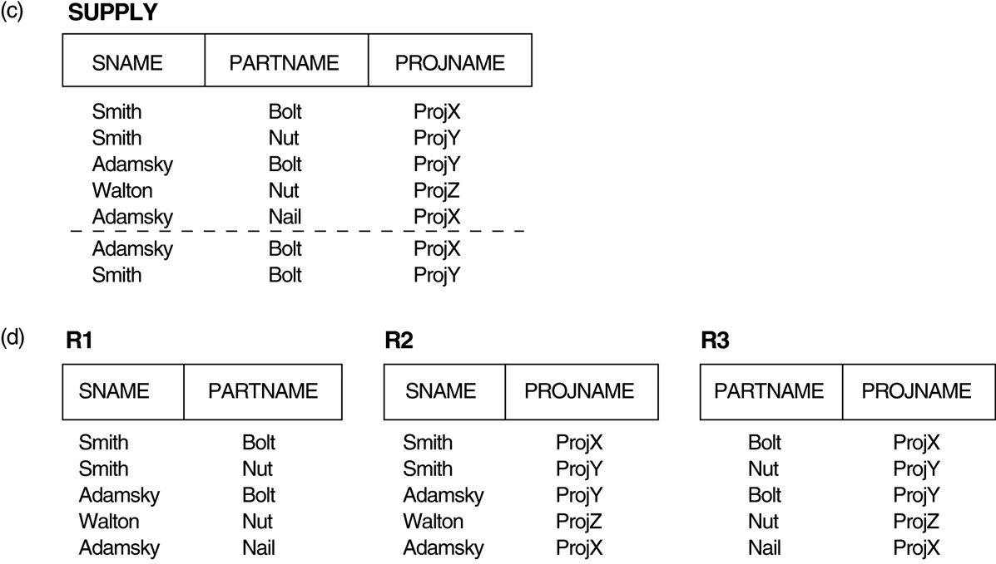
Join Dependencies and Fifth Normal Form
A relation schema R is in fifth normal form (5NF) (or Project-Join Normal Form (PJNF)) with respect to a set F of functional, multivalued, and join dependencies
if, for every nontrivial join dependency JD(R₁, R₂, ..., R_{n}) in F⁺ (that is, implied by F), every R_{i} is a superkey of R.
(c) The relation SUPPLY with no MVDs is in 4NF but not in 5NF if it has the JD(R1, R2, R3).
(d) Decomposing the relation SUPPLY into the 5NF relations R1, R2, and R3.

